Slide 1
BA With R Project Predicting Cancellations of Hotel Bookings
Group Number 10
By:
Likith Vinayaka Giridhar (LXG210034)
Praful Patil (PVP220001)
Sai Rohit Boggarapu (SXB220120)
Rahul Kintali (RXK210144)

Slide 2

Business context:
Dataset provides a wealth of information on bookings made at a city hotel and a resort hotel
With data points including booking dates, length of stay, and party size, average daily rate as well as details on parking availability
Data set has the potential to transform our understanding and analysis of hotel bookings, providing valuable insights for anyone interested in the hospitality industry.

Slide 3
Let us discuss our Dataset
The target variable is canceled which represents binary classes 0 and 1 where 0 is Not Cancelled and 1 is Cancelled
The remaining variables provide additional details about the booking, including lead time, arrival date, length of stay, number of guests, type of meal, country of origin, market segment, distribution channel, room type, deposit type, and more.
Some of the variables have numerical values, while others are categorical with various levels of categories.
The dataset layout provides a tabular format with rows representing individual bookings and columns representing attributes of the bookings.
The dataset could be useful for analyzing patterns in hotel bookings and predicting future bookings, as well as identifying factors that contribute to cancellations.

Slide 4
Explored Interesting Libraries:
Dplyr: Used for creating pipelines to build subsets of data frames and data frames summary.
Tidyr: Used in conjunction with dplyr to clean data.
Plotly: Used to create interactive plots (annotations)
FactoMineR: Exploratory data analysis methods to summarize, visualize and describe data.
Countrycode: Used for converting country names and codes from one format to another.
Lubridate: To manipulate date.
Mice: Used for imputing data.

Slide 5
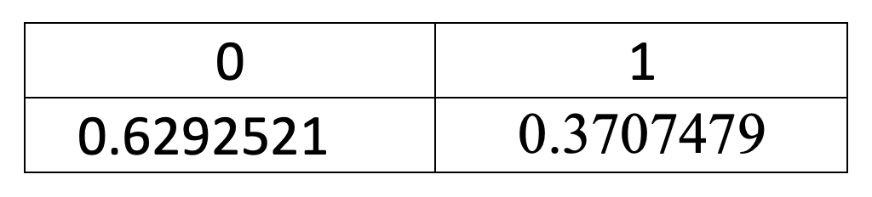
Challenges faced
Dataset imbalance: Our dataset has a slight class imbalance, which may affect the accuracy of our binary class statistics scores.
Missing values: The "Company" column has missing values, and we have excluded it from our analysis to ensure data integrity and accuracy.
Handling categorical variables: One-hot encoding and PCA for categorical data would increase the dimensionality of the dataset significantly, requiring high computational power and time.
Feature selection: High correlation with target variable: The "reservation_status" column, a categorical variable, has almost 100% correlation with our target variable, so we removed it from our analysis to avoid potential bias. Note that this anomaly is not reflected in the correlation heat map as it only considers numerical variables.

Slide 6
Data cleaning, manipulation and Data Pre-Processing for data visualization and model building
Eliminate NA and other undefined values – Omit missing Records
Some rows contain entries with zero adults, children, and babies, so we deleted these records as they have Zero guests.
Meal column having “Undefined” values have been replaced by Mode value.
Records with “Undefined” values in “market_segment” and “distribution_channel” have been deleted.
Plotting Heat Map to check for correlation in numeric data: We observe that none of the numeric variables are highly correlated to the target variable “is_canceled”
Based on Intuition, we remove some of the irrelevant columns such as “agent”, “company”, “reservation_status_date”. Also company column has a lot of missing values.
We also remove the categorical variable “reservation_status” because of 100% correlation with our target variable “is_canceled”
We replace missing values with the mode for categorical variables, we impute children=”0”, country=”Unknown”, meal=”SC”
We replace missing values of numeric variables with their median, for variables “lead_time” and “required_car_parking_spaces”

Slide 7
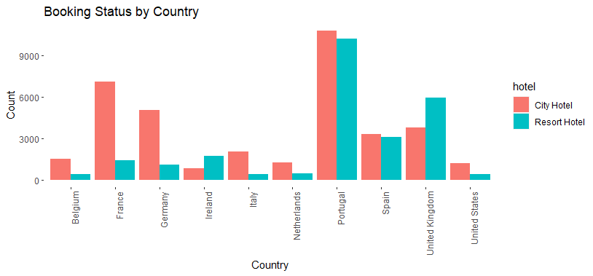
Where do the guests come from?
Subset the data to include the countries which has more than 1500 reservation request otherwise including all the country with few or occasional request to avoid the graph from being clumsy. The highest number of tourists are from Portugal. The countries other than Portugal where the guests frequent are from Portugal’s neighboring Countries in Europe.

Slide 8
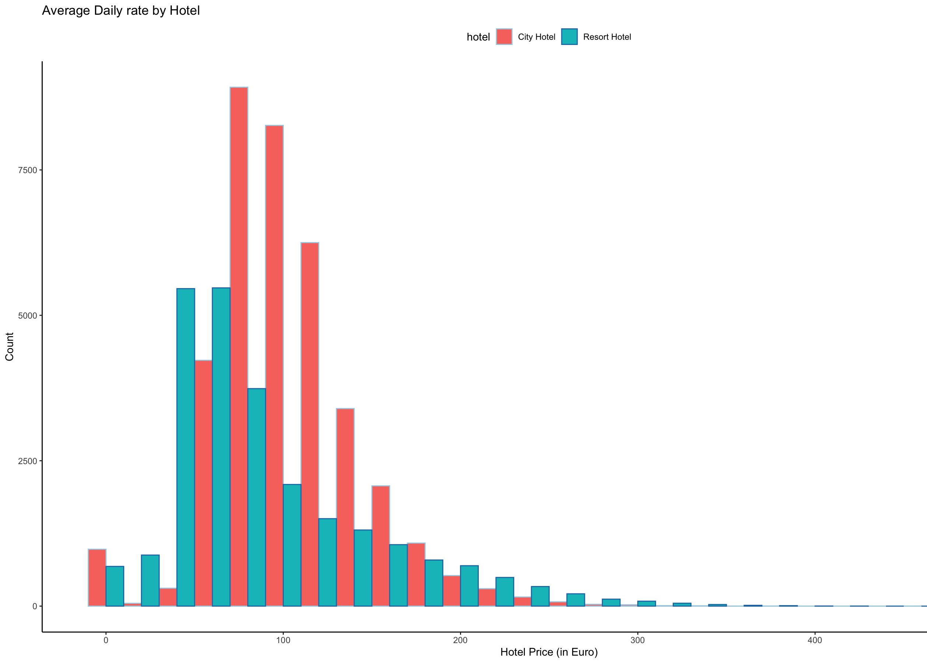
How much do guests pay for a room per night?
From the plot below we can examine that the average daily rate for City hotels are higher that Resort hotels.
On an average a guest pays around 80-120 Euros per night.
We can see that the demand for the city hotel is higher compared to resort hotel, this will account to higher price per room per night.

Slide 9
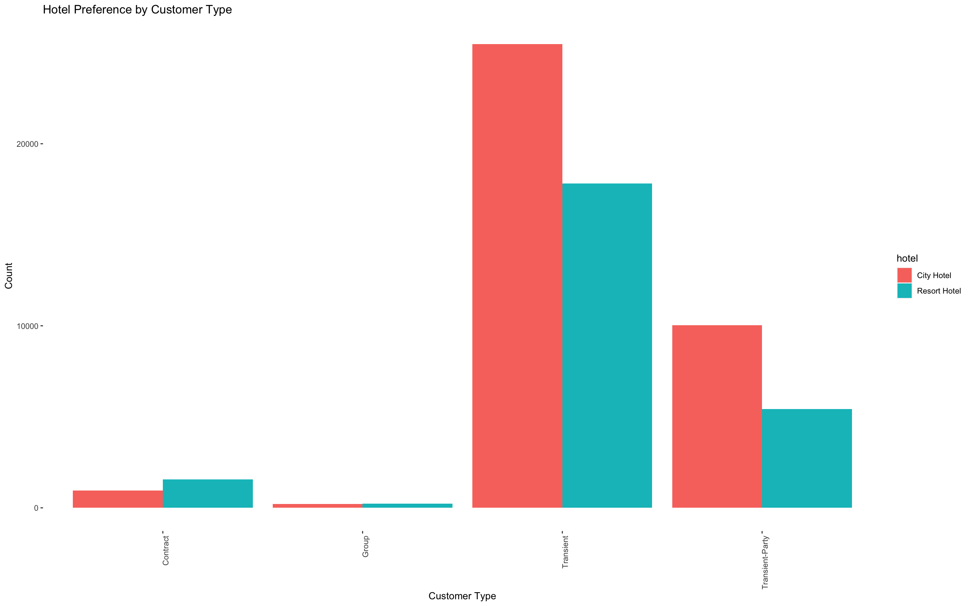
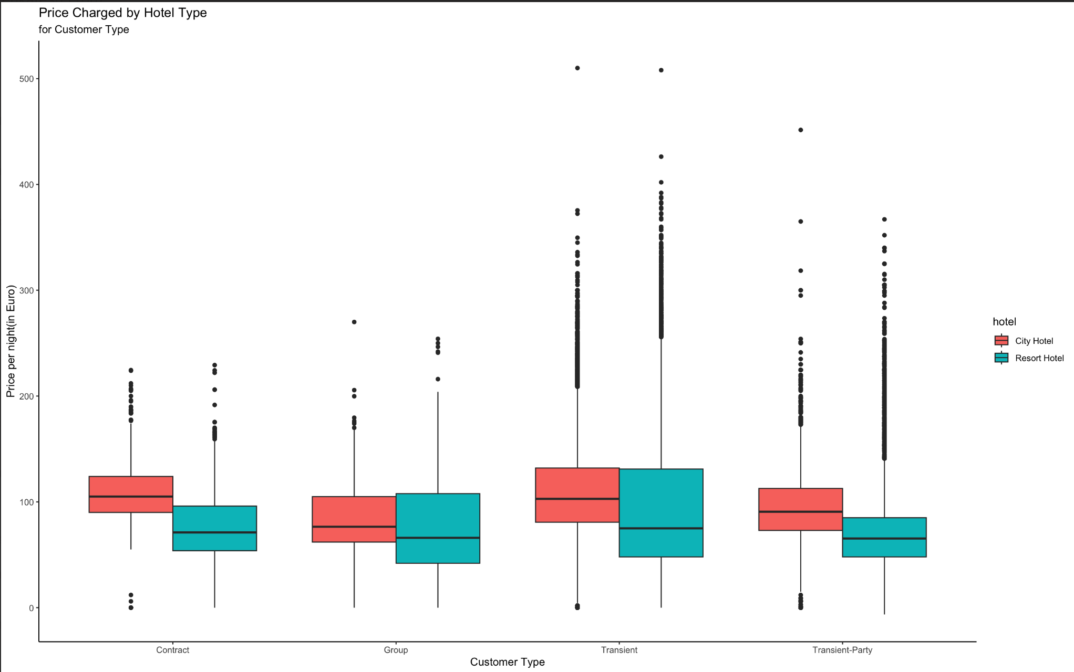
How much do guests pay for a room per night?
The highest number of guests are from transient customer type bookings and lowest being for group customer type bookings. This trend can be seen for both the hotel types.
Prices charged by both the hotel types for different customer types remains more or less the same.
The spread of outliers is extremely large for Transient and Transient-Party

Slide 10
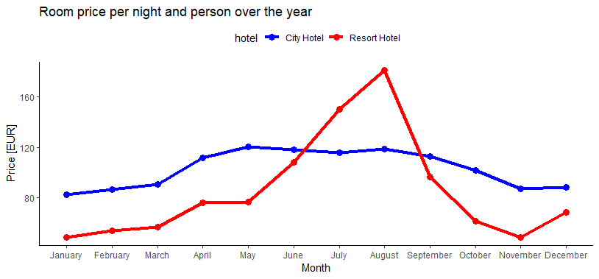
How does the price per night vary over the year?
We can notice that this is a peak and valley plot. The price per night is maximum in August and Minimum in January and November for resort hotel. For Resort hotel the price hikes from May to August and drops till November. The price drop can be attributed to the winter weather from November to January after which the price starts to increase.

Slide 11
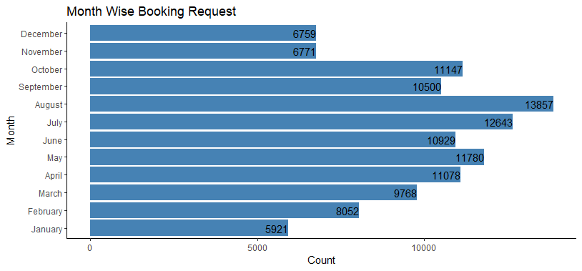
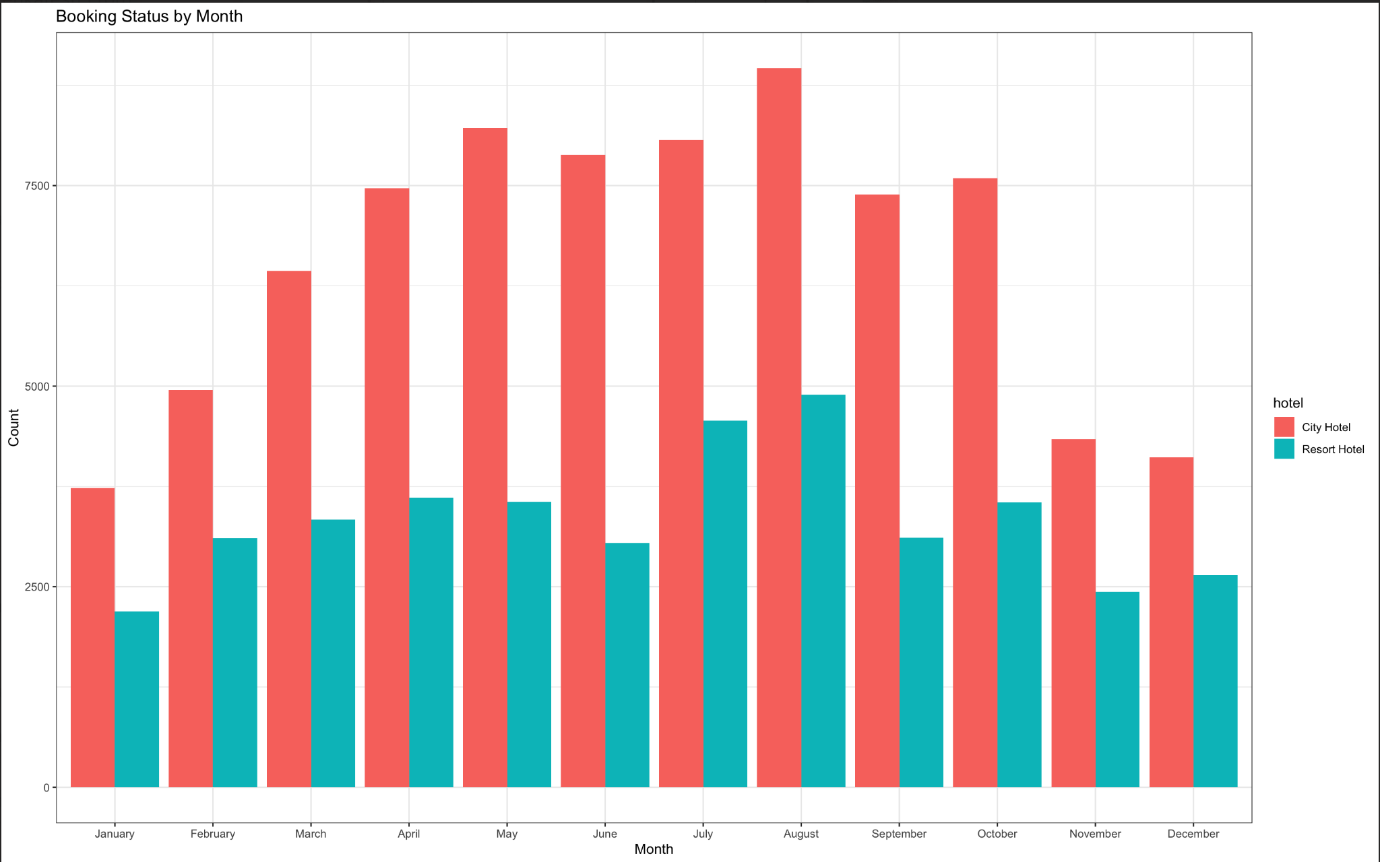
Which are the Busiest Month?
For city hotel we can see the bookings consistently remain around 7500 or more from April to October and the bookings drop in winter months. This trend is very similar in resort hotels but the bookings hover around half of city hotels

Slide 12
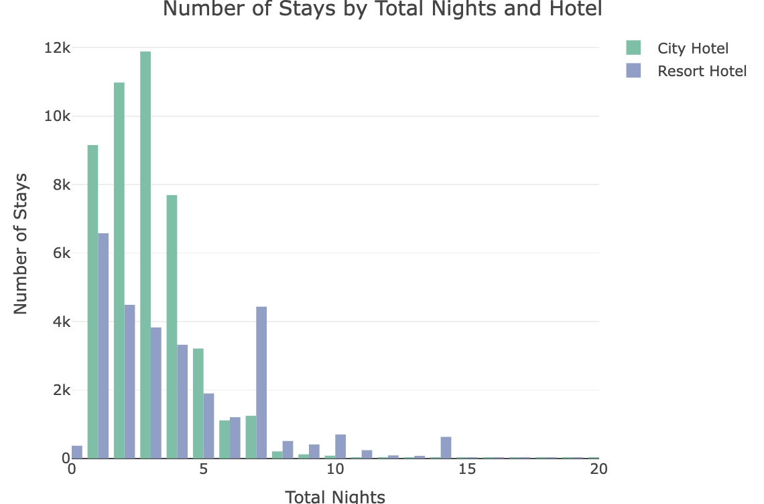
How long do people stay at the hotels?
We can notice that most of the people stay for around 3 nights at a hotel and maximum people stay on an average of between 0-5 days. Also, the trend is similar in for both the hotels

Slide 13
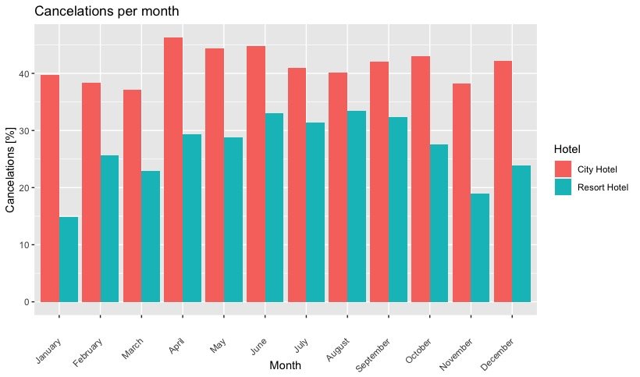
How many bookings were cancelled?
There were 37% of total bookings cancelled and in that City Hotel has more cancellations.
Total bookings canceled: 44,195 (37% of all the bookings)
Resort hotel bookings canceled: 11,120 (28% of all Resort bookings)
City hotel bookings canceled: 33,075 (42% of all City bookings)
Which month have the highest number of cancellations?
Looking at the plot below we can notice that although the cancellations for city hotel is highest in April and for resort hotel it is in August. We have taken percentages as it gives a normalized understanding of the figures.

Slide 14
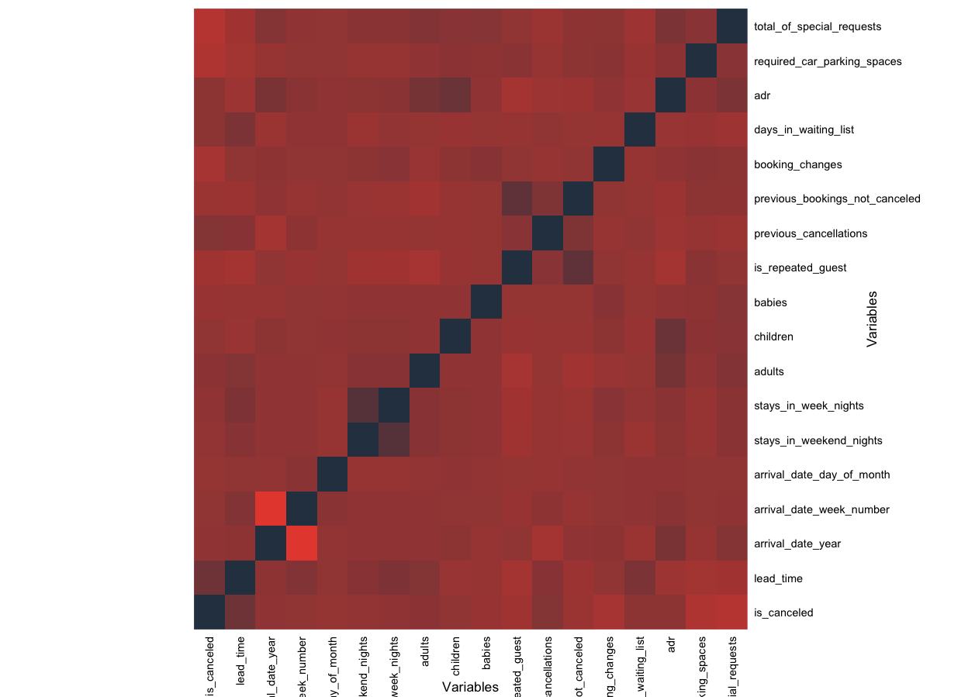
Data Preprocessing and Cleaning in preparation for modeling
Correlation Heat map: None of the numeric Variables seem to be highly correlated with the target variable
But the categorical variable “reservation_status” has 100% correlation with our target variable “is_canceled”, hence we go ahead and remove it

Slide 15
Feature Engineering:
We combine arrival_date_year, arrival_date_month, arrival_date_day_of_month to form a new variable called arrival_date
Create a new variable called total_guests by adding the number of adults, children, and babies.
Then we convert the categorical variables to factors
Principal Component Analysis:
We perform Principal Component Analysis on numeric variables.
We merge the PCA values with the categorical variables.
We use the first 3 components which capture majority of the data

Slide 16
Logistic Regression Model
CLASSIFICATION MODELS
Random Forest Model
We build a Logistic Regression Model of 5 fold cross validation and obtain the following by class statistics when we apply model on the test data
Accuracy: 0.7894
AUC: 0.7348
Sensitivity: 0.9460
F1_score: 0.6483
The accuracy on prediction on training data and testing data is 0.78 which is the same as the accuracy obtained on testing data.
We also build a Random Forest Model of 500 trees we observe the following by class statistics when we test on the test data: Number of trees: 500
No. of variables tried at each split: 4
Accuracy: 0.8378
AUC: 0.80469
Sensitivity: 0.6750
F1_score: 0.75530
The accuracy obtained on training data is 0.908 and for test data it is 0.8378 which is a very good score.

Slide 17
Conclusion
Based on the above metrics, the Random Forest model appears to be the better choice for the hotel booking cancellation prediction problem, as it has higher accuracy, Kappa score, specificity, positive predictive value, negative predictive value, F1 score, and AUC compared to the Logistic Regression model.
Future Work
Performing oversampling or under sampling on the target variable and re-running the models to analyse performance.
Check the dependence of target variable on each level of each of the categorical variables. Then select the necessary categories and one hot encode. Finally perform PCA on the one hot encoded categorical sub data frame

